Slide 1

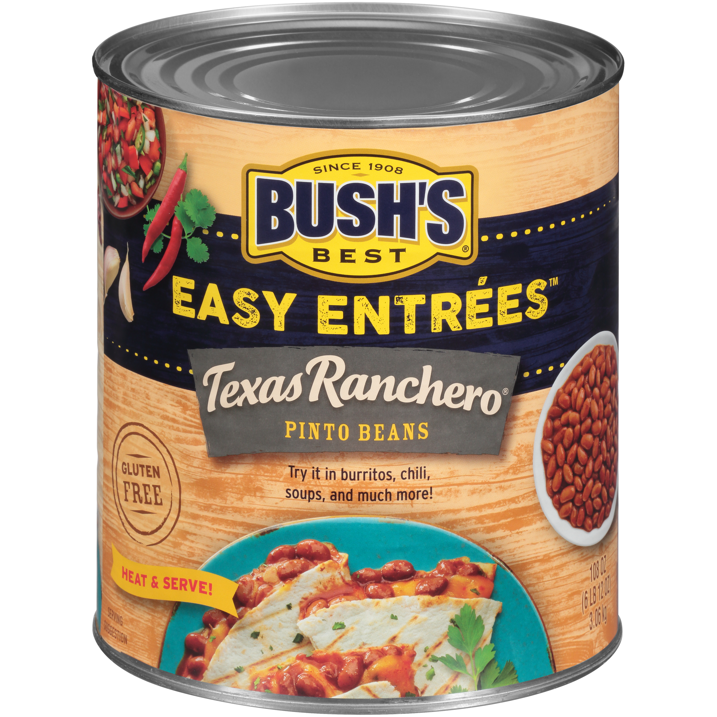

01071 - Bush's Easy Entrees Texas Ranchero 108 oz
Treat your patrons to the authentic, bold flavor of the Southwest with Bush's Easy Entrees Texas Ranchero Pinto Beans. Seasoned with Mexican oregano, cumin, and onion these savory beans have a slight hint of spice for a kick in the taste buds. Try Bush's Easy Entrees Texas Ranchero Pinto Beans as a flavorful addition to a taco salad, served simply on a scoop of rice, or use your favorite ingredients for signature charro beans they won't soon forget!
Brand: Bush's Best
Nutrition Facts
23 servings per container
Serving Size |  |  | 1/2 cup (130g)
Amount per serving |  |  | 110
Calories
% Daily Value*
Total Fat 0.5g |  |  | 1%
Saturated Fat 0g |  |  | 0%
Trans Fat 0g
Cholesterol 0mg |  |  | 0%
Sodium 490mg |  |  | 21%
Total Carbohydrate 20g |  |  | 7%
Dietary Fiber 5g |  |  | 17%
Total Sugars 1g
 | Includes 0g Added Sugars |  |  | 0%
Protein 6g
⎯⎯⎯⎯⎯⎯⎯⎯⎯⎯⎯⎯⎯⎯⎯⎯⎯⎯⎯⎯⎯⎯⎯⎯⎯⎯⎯⎯⎯⎯⎯⎯⎯⎯⎯⎯⎯⎯⎯⎯⎯
Vitamin D 0mcg 0% |  | Calcium 42mg 4% | Calcium 42mg 4%
Iron 2mg 10% |  | Potassium 400mg 8% | Potassium 400mg 8%
⎯⎯⎯⎯⎯⎯⎯⎯⎯⎯⎯⎯⎯⎯⎯⎯⎯⎯⎯⎯⎯⎯⎯⎯⎯⎯⎯⎯⎯⎯⎯⎯⎯⎯⎯⎯⎯⎯⎯⎯⎯⎯ *The % Daily Value (DV) tells you how much a nutrient in a serving of food contributes to a daily diet. 2,000 calories a day is used for general nutrition advice.
Ingredients
Prepared Pinto Beans, Water, Tomato Puree (Tomato Paste, Water). Contains 1% or Less of: Mexican Oregano, Tomato Powder, Spice, Onion Powder, Garlic Powder, Natural Flavor, Modified Corn Starch, Jalapeño Powder, Salt, Extractive of Paprika.
Case Specifications
GTIN | 10039400010712 | Case Gross Weight | Case Gross Weight | 45.8 LB
Pack Size | 6/108 oz cans | Case Net Weight | Case Net Weight | 40.5 LB
Shelf Life | 730 days | Case L, W, H | Case L, W, H | 18.75 IN, 12.5 IN, 7 IN
Tie x High | 8 x 7 | Cube | Cube | 0.949 CF
Each Specifications
GTIN | 00039400010715 | Each Gross Weight | Each Gross Weight | 122 ONZ
UPC | 039400010715 | Each Net Weight | Each Net Weight | 108 ONZ
Unit Size | / 108 ONZ | Each L, W, H | Each L, W, H | 6.19 IN, 6.19 IN, 7 IN
 |  | Cube | Cube | 0.155 CF
Preparation and Cooking
Simmer: Empty contents into saucepan. Heat to simmer.
Serving Suggestions
Heat and Serve
Packaging and Storage
Store in a clean dry place
Allergens
FREE FROM: Eggs or Egg Derivatives, Fish or Fish Derivatives, Milk or Milk Derivatives, Peanuts or Peanut Derivatives, Sesame Seeds or Sesame Derivatives, Soybeans or Soybean Derivatives, Tree Nuts or Tree Nut Derivatives, Wheat or Wheat Derivatives, Crustaceans or Crustacean Derivatives
Barcodes
Each Barcode:
Bush Brothers & Company | 1016 East Weisgarber Rd., Knoxville TN 37909 | bushbeansfoodservice.com | SKU Updated 09.04.2019, Printed 04.09.2024

