Slide 1

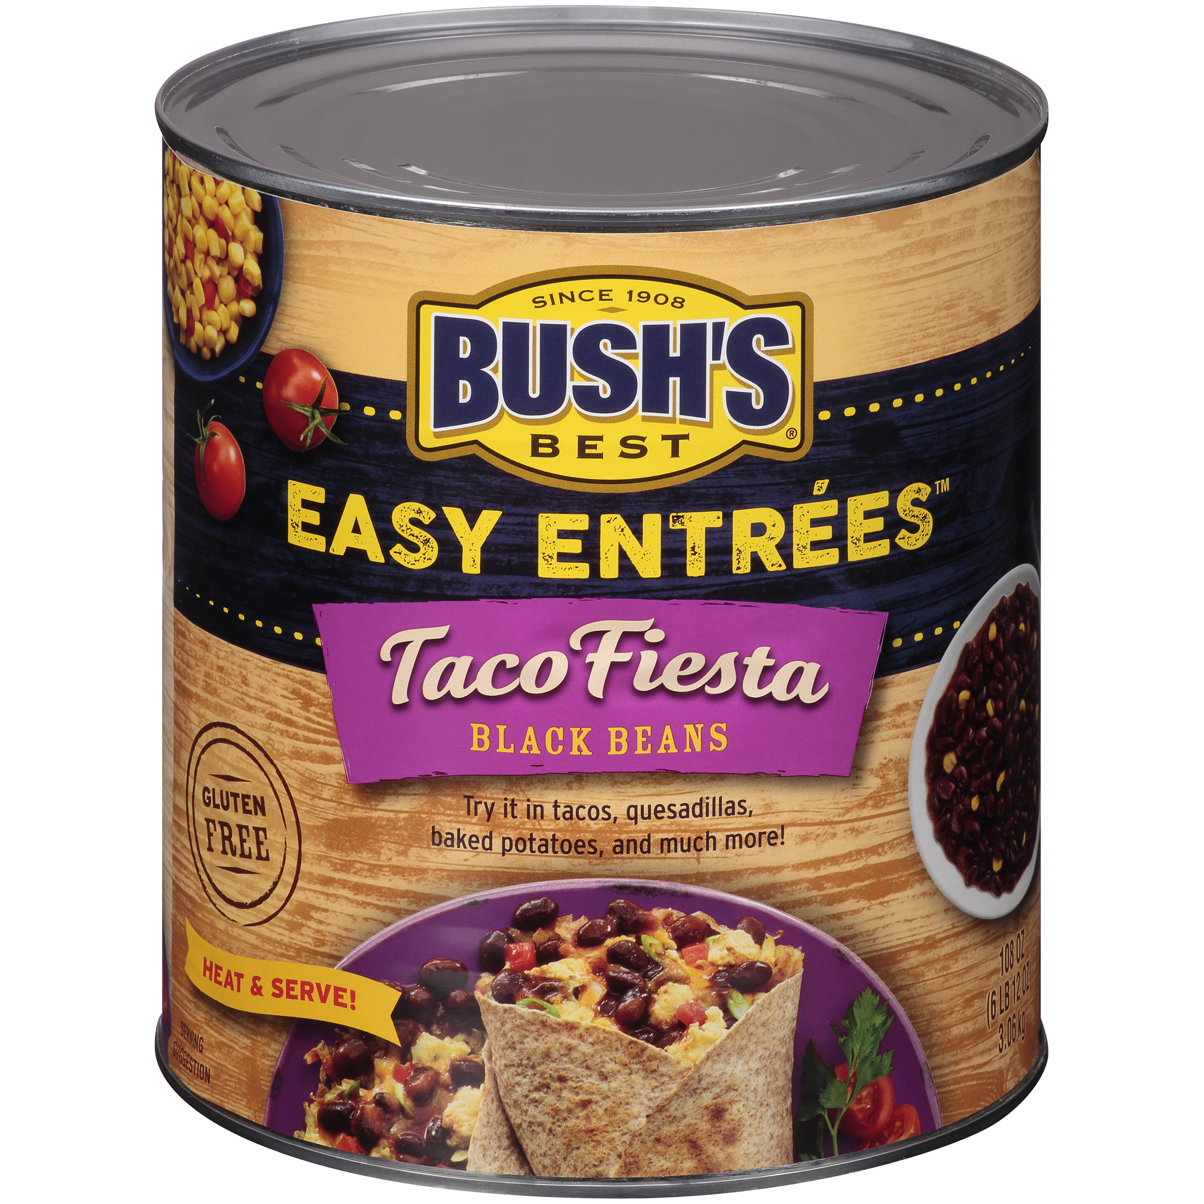

01585 - Bush's Taco Fiesta Black Beans 108 oz
A fiesta for the senses, this black bean easy entrée is as delicious as it is versatile. The dark, rich beans are immersed in a not-too-spicy sauce enhanced with a zesty mix of authentic Mexican seasonings. As a stand-alone dip, the centerpiece of a burrito, or an unexpected topping, Bush's Taco Fiesta Black Beans brings new life to vegetarian recipes and new excitement to any menu.
Brand: Bush's Best
Nutrition Facts
23 servings per container
Serving Size |  |  | 1/2 cup (130g)
Amount per serving |  |  | 120
Calories
% Daily Value*
Total Fat 0.5g |  |  | 1%
Saturated Fat 0g |  |  | 0%
Trans Fat 0g
Cholesterol 0mg |  |  | 0%
Sodium 460mg |  |  | 20%
Total Carbohydrate 22g |  |  | 8%
Dietary Fiber 5g |  |  | 18%
Total Sugars 1g
 | Includes 0g Added Sugars |  |  | 0%
Protein 7g
⎯⎯⎯⎯⎯⎯⎯⎯⎯⎯⎯⎯⎯⎯⎯⎯⎯⎯⎯⎯⎯⎯⎯⎯⎯⎯⎯⎯⎯⎯⎯⎯⎯⎯⎯⎯⎯⎯⎯⎯⎯
Vitamin D 0mcg 0% |  | Calcium 48mg 4% | Calcium 48mg 4%
Iron 2mg 10% |  | Potassium 480mg 10% | Potassium 480mg 10%
⎯⎯⎯⎯⎯⎯⎯⎯⎯⎯⎯⎯⎯⎯⎯⎯⎯⎯⎯⎯⎯⎯⎯⎯⎯⎯⎯⎯⎯⎯⎯⎯⎯⎯⎯⎯⎯⎯⎯⎯⎯⎯ *The % Daily Value (DV) tells you how much a nutrient in a serving of food contributes to a daily diet. 2,000 calories a day is used for general nutrition advice.
Ingredients
Prepared Black Beans, Water, Sweet Corn, Tomato Puree (Tomato Paste, Water). Contains 1% or Less of: Onion Powder, Spice, Garlic Powder, Tomato Powder, Extractive of Paprika, Salt, Natural Flavor, Modified Corn Starch.
Case Specifications
GTIN | 10039400015854 | Case Gross Weight | Case Gross Weight | 45.8 LB
Pack Size | 6/108 oz | Case Net Weight | Case Net Weight | 40.5 LB
Shelf Life | 730 days | Case L, W, H | Case L, W, H | 18.75 IN, 12.5 IN, 7 IN
Tie x High | 8 x 7 | Cube | Cube | 0.949 CF
Each Specifications
GTIN | 00039400015857 | Each Gross Weight | Each Gross Weight | 118 ONZ
UPC | 039400015857 | Each Net Weight | Each Net Weight | 108 ONZ
Unit Size | / 108 ONZ | Each L, W, H | Each L, W, H | 6.19 IN, 6.19 IN, 7 IN
 |  | Cube | Cube | 0.155 CF
Preparation and Cooking
Simmer: Empty contents into saucepan. Heat to simmer.
Serving Suggestions
Great in rice, burritos, baked potatoes, and quesadillas
Packaging and Storage
Store in a clean dry place
Allergens
FREE FROM: Eggs or Egg Derivatives, Fish or Fish Derivatives, Milk or Milk Derivatives, Peanuts or Peanut Derivatives, Sesame Seeds or Sesame Derivatives, Soybeans or Soybean Derivatives, Tree Nuts or Tree Nut Derivatives, Wheat or Wheat Derivatives, Crustaceans or Crustacean Derivatives
Barcodes
Each Barcode:
Bush Brothers & Company | 1016 East Weisgarber Rd., Knoxville TN 37909 | bushbeansfoodservice.com | SKU Updated 09.04.2019, Printed 04.09.2024

