Slide 1

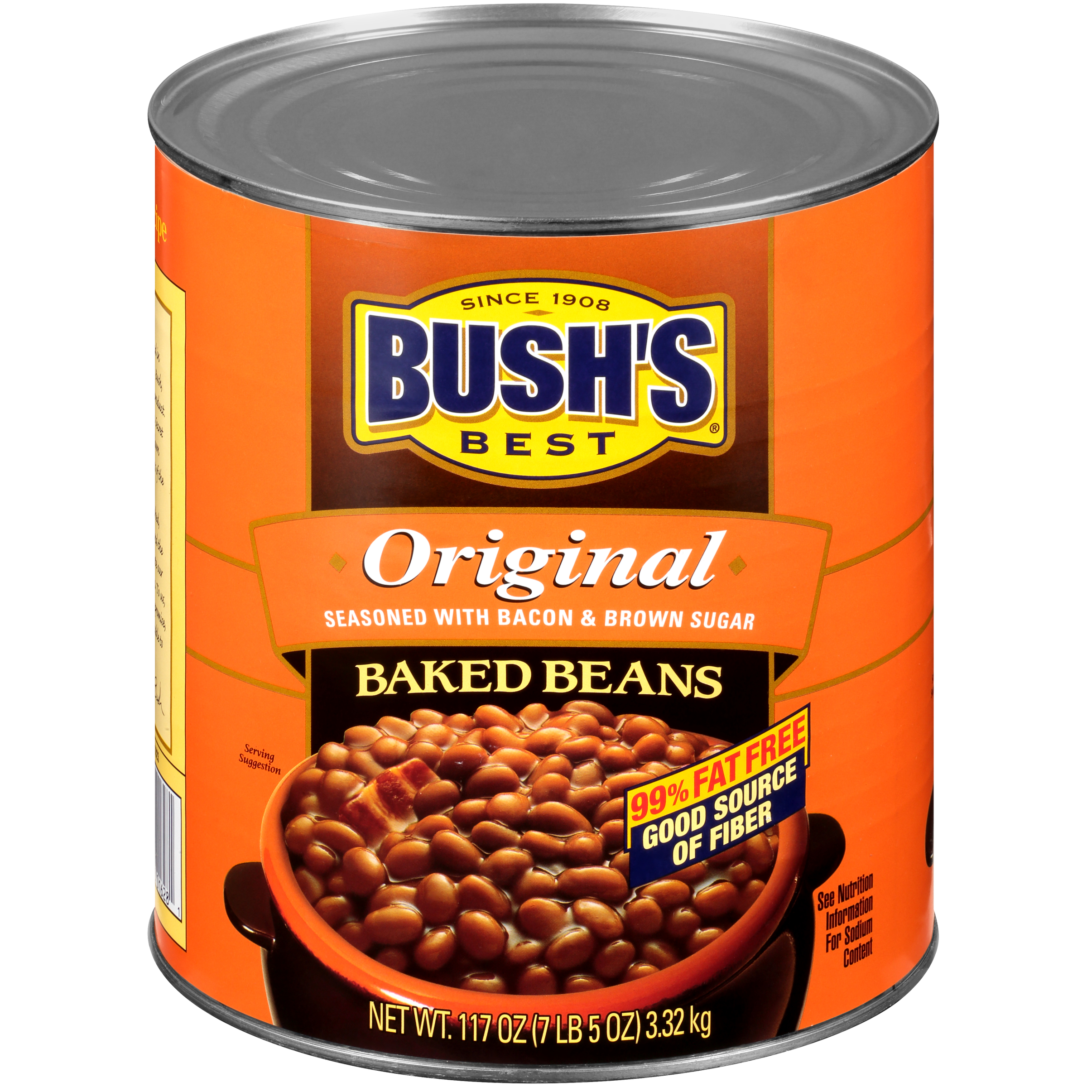

01628 - Bush's Original Baked Beans 117 oz
When hamburgers and hot dogs are on your table, it only makes sense that Bush's Baked Beans go on the side. Our Secret Family Recipe uses tender navy beans, slow-simmered with real bacon, fine brown sugar and a signature blend of spices. So whether you're fixing up a summer cookout, a weeknight meal or anything in between, you can be sure you've got perfectly sweet beans to go along with every savory bite.
Brand: Bush's Best
Nutrition Facts
26 servings per container
Serving Size |  |  | 1/2 cup (130g)
Amount per serving |  |  | 150
Calories
% Daily Value*
Total Fat 0.5g |  |  | 1%
Saturated Fat 0g |  |  | 0%
Trans Fat 0g
Cholesterol 0mg |  |  | 0%
Sodium 550mg |  |  | 24%
Total Carbohydrate 30g |  |  | 11%
Dietary Fiber 5g |  |  | 17%
Total Sugars 12g
 | Includes 11g Added Sugars |  |  | 21%
Protein 7g |  |  | 9%
⎯⎯⎯⎯⎯⎯⎯⎯⎯⎯⎯⎯⎯⎯⎯⎯⎯⎯⎯⎯⎯⎯⎯⎯⎯⎯⎯⎯⎯⎯⎯⎯⎯⎯⎯⎯⎯⎯⎯⎯⎯
Vitamin D 0mcg 0% |  | Calcium 50mg 4% | Calcium 50mg 4%
Iron 1.9mg 10% |  | Potassium 380mg 8% | Potassium 380mg 8%
⎯⎯⎯⎯⎯⎯⎯⎯⎯⎯⎯⎯⎯⎯⎯⎯⎯⎯⎯⎯⎯⎯⎯⎯⎯⎯⎯⎯⎯⎯⎯⎯⎯⎯⎯⎯⎯⎯⎯⎯⎯⎯ *The % Daily Value (DV) tells you how much a nutrient in a serving of food contributes to a daily diet. 2,000 calories a day is used for general nutrition advice.
Ingredients
Prepared Navy Beans, Water, Brown Sugar. Contains 2% or Less of: Cured Bacon, Salt, Mustard (Water, Vinegar, Mustard Seed, Salt, Paprika, Turmeric), Modified Corn Starch, Onion Powder, Caramel Color, Spice, Garlic Powder, Natural Flavor.
Case Specifications
GTIN | 10039400016288 | Case Gross Weight | Case Gross Weight | 48.3 LB
Pack Size | 6/117 oz | Case Net Weight | Case Net Weight | 43.88 LB
Shelf Life | 730 days | Case L, W, H | Case L, W, H | 18.75 IN, 12.5 IN, 7 IN
Tie x High | 8 x 7 | Cube | Cube | 0.949 CF
Each Specifications
GTIN | 00039400016281 | Each Gross Weight | Each Gross Weight | 128 ONZ
UPC | 039400016281 | Each Net Weight | Each Net Weight | 117 ONZ
Unit Size | / 117 ONZ | Each L, W, H | Each L, W, H | 6.19 IN, 6.19 IN, 7 IN
 |  | Cube | Cube | 0.155 CF
Preparation and Cooking
Simmer: Empty contents into saucepan. Heat to simmer.
Serving Suggestions
Heat and Serve.
Packaging and Storage
Store in a clean dry place
Allergens
FREE FROM: Eggs or Egg Derivatives, Fish or Fish Derivatives, Milk or Milk Derivatives, Peanuts or Peanut Derivatives, Sesame Seeds or Sesame Derivatives, Soybeans or Soybean Derivatives, Tree Nuts or Tree Nut Derivatives, Wheat or Wheat Derivatives, Crustaceans or Crustacean Derivatives
Barcodes
Each Barcode:
Bush Brothers & Company | 1016 East Weisgarber Rd., Knoxville TN 37909 | bushbeansfoodservice.com | SKU Updated 09.04.2019, Printed 04.09.2024

