Slide 1
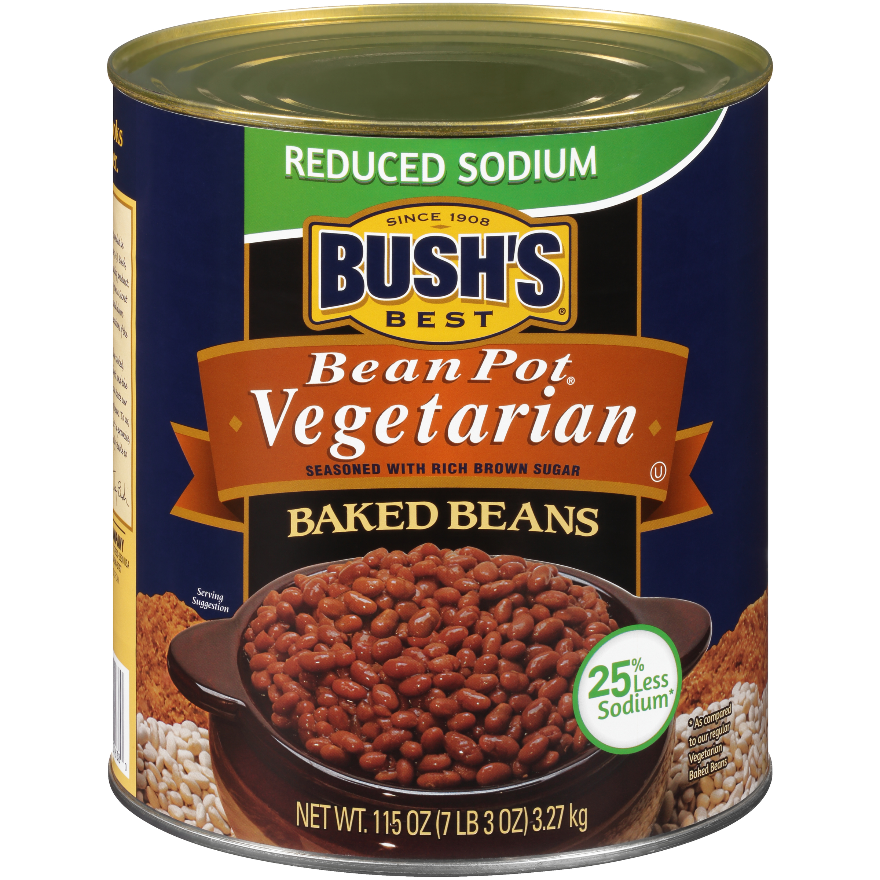
001638 - Bush's Bean Pot Reduced Sodium Vegetarian Baked Beans 115 oz
Whether it's hot dogs, hamburgers, turkey burgers or a meat-less favorite on your table, it only makes sense that Bush's Baked Beans go on the side. Our Bean Pot Reduced Sodium Vegetarian Baked Beans are tender navy beans, slow-simmered in rich brown sugar and a signature blend of spices for a sauce that's high in flavor but has 25% less sodium than our regular Baked Beans. So the next time you're fixing up a big meal, you can be sure you've got perfectly sweet beans to go along with every savory bite.
Brand: Bush's Best
Nutrition Facts
25 servings per container
Serving Size |  |  | 1/2 cup (130g)
Amount per serving |  |  | 150
Calories
% Daily Value*
Total Fat 0g |  |  | 0%
Saturated Fat 0g |  |  | 0%
Trans Fat 0g
Cholesterol 0mg |  |  | 0%
Sodium 370mg |  |  | 16%
Total Carbohydrate 30g |  |  | 11%
Dietary Fiber 5g |  |  | 17%
Total Sugars 12g
 | Includes 11g Added Sugars |  |  | 22%
Protein 7g |  |  | 9%
⎯⎯⎯⎯⎯⎯⎯⎯⎯⎯⎯⎯⎯⎯⎯⎯⎯⎯⎯⎯⎯⎯⎯⎯⎯⎯⎯⎯⎯⎯⎯⎯⎯⎯⎯⎯⎯⎯⎯⎯⎯
Vitamin D 0mcg 0% |  | Calcium 50mg 4% | Calcium 50mg 4%
Iron 1.9mg 10% |  | Potassium 370mg 8% | Potassium 370mg 8%
⎯⎯⎯⎯⎯⎯⎯⎯⎯⎯⎯⎯⎯⎯⎯⎯⎯⎯⎯⎯⎯⎯⎯⎯⎯⎯⎯⎯⎯⎯⎯⎯⎯⎯⎯⎯⎯⎯⎯⎯⎯⎯ *The % Daily Value (DV) tells you how much a nutrient in a serving of food contributes to a daily diet. 2,000 calories a day is used for general nutrition advice.
Ingredients
Prepared Navy Beans, Water, Brown Sugar. Contains 2% or less of: Salt, Mustard (Water, Vinegar, Mustard Seed, Salt, Paprika, Turmeric), Modified Corn Starch, Onion Powder, Caramel Color, Spice, Garlic Powder, Natural Flavor.
Case Specifications
GTIN | 10039400016387 | Case Gross Weight | Case Gross Weight | 47.55 LB
Pack Size | 6/115 oz | Case Net Weight | Case Net Weight | 43.13 LB
Shelf Life | 730 days | Case L, W, H | Case L, W, H | 18.75 IN, 12.5 IN, 7 IN
Tie x High | 8 x 7 | Cube | Cube | 0.949 CF
Each Specifications
GTIN | 00039400016380 | Each Gross Weight | Each Gross Weight | 125 ONZ
UPC | 039400016380 | Each Net Weight | Each Net Weight | 115 ONZ
Unit Size | / 115 ONZ | Each L, W, H | Each L, W, H | 6.19 IN, 6.19 IN, 7 IN
 |  | Cube | Cube | 0.155 CF
Preparation and Cooking
Microwave: Empty contents into microwave-safe container. Cover. Heat 1-2 minutes. Stir and serve. Simmer: Empty contents into saucepan. Heat to simmer.
Serving Suggestions
Heat and Serve
Packaging and Storage
Store in a clean dry place.
Allergens
FREE FROM: Eggs or Egg Derivatives, Fish or Fish Derivatives, Milk or Milk Derivatives, Peanuts or Peanut Derivatives, Sesame Seeds or Sesame Derivatives, Soybeans or Soybean Derivatives, Tree Nuts or Tree Nut Derivatives, Wheat or Wheat Derivatives, Crustaceans or Crustacean Derivatives
Barcodes
Each Barcode:
Bush Brothers & Company | 1016 East Weisgarber Rd., Knoxville TN 37909 | bushbeansfoodservice.com | SKU Updated 09.04.2019, Printed 04.09.2024

