Slide 1
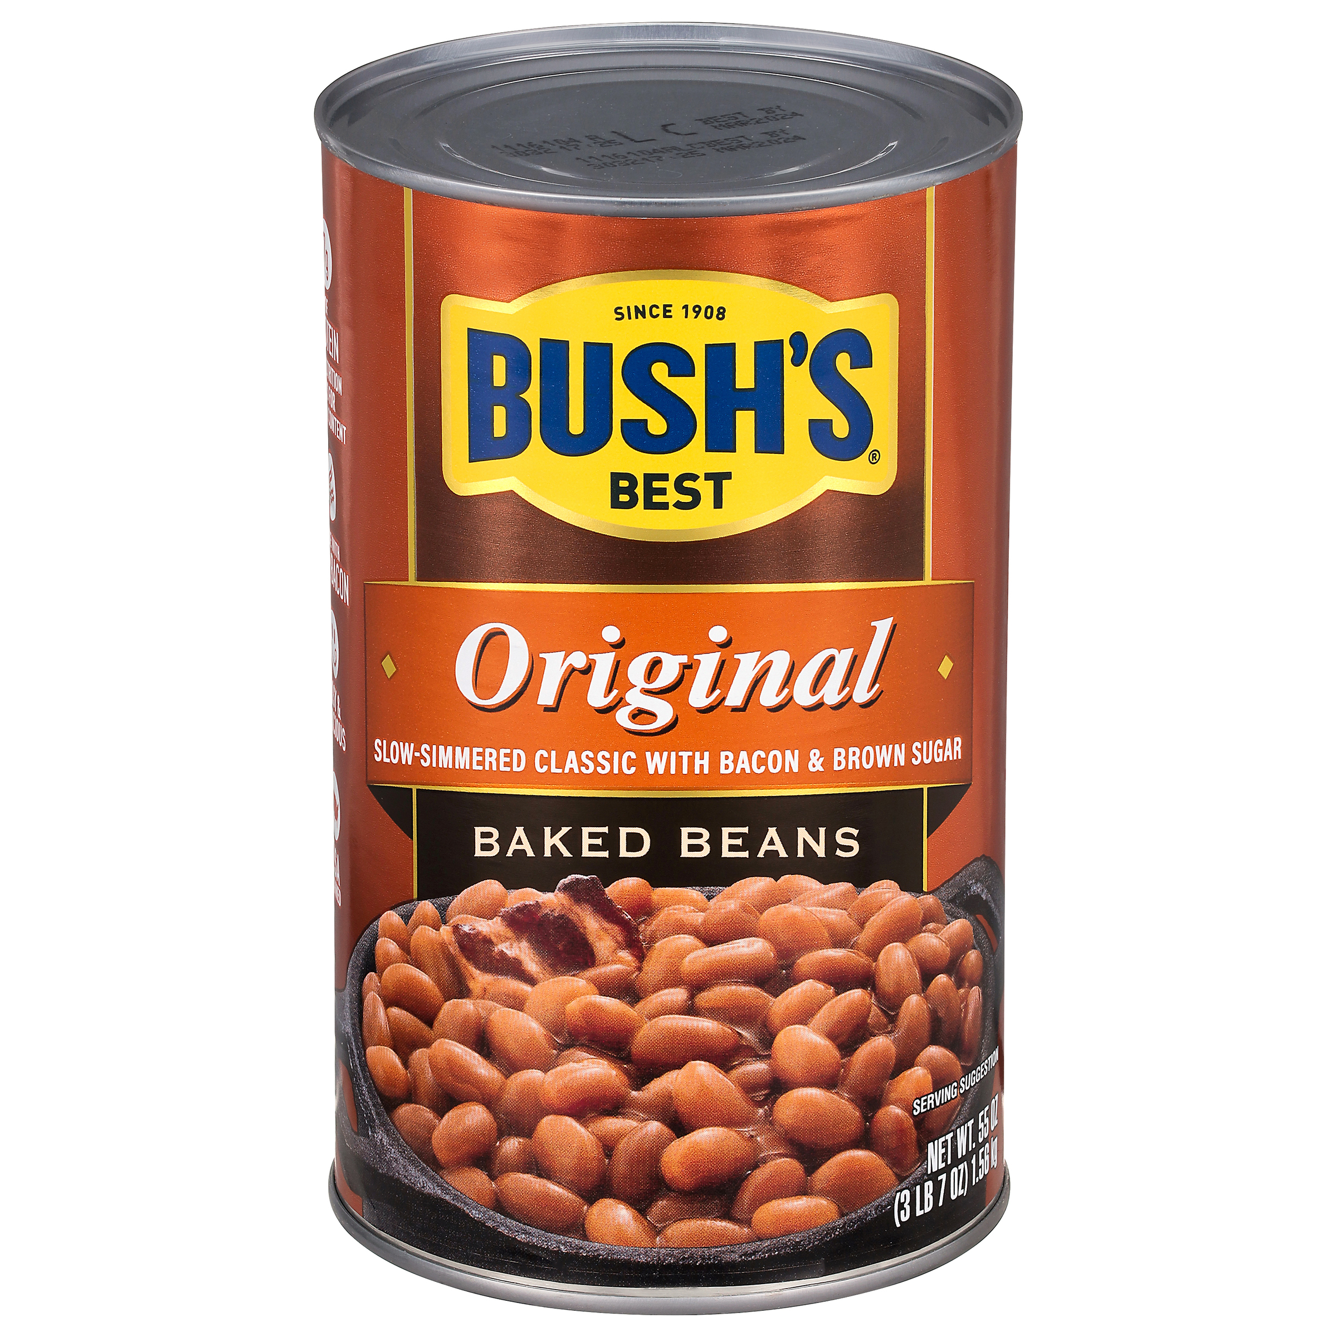
01647 - Bush's Original Baked Beans 55 oz
When hamburgers and hot dogs are on your table, it only makes sense that Bush's Baked Beans go on the side. Our Secret Family Recipe uses tender navy beans, slow-simmered with real bacon, fine brown sugar and a signature blend of spices. So whether you're fixing up a summer cookout, a weeknight meal or anything in between, you can be sure you've got perfectly sweet beans to go along with every savory bite.
Brand: Bush's Best
Nutrition Facts
12 servings per container
Serving Size |  |  | 1/2 cup (130g)
Amount per serving |  |  | 150
Calories
% Daily Value*
Total Fat 1g |  |  | 1%
Saturated Fat 0g |  |  | 0%
Trans Fat 0g
Cholesterol 0mg |  |  | 0%
Sodium 570mg |  |  | 25%
Total Carbohydrate 30g |  |  | 11%
Dietary Fiber 5g |  |  | 17%
Total Sugars 12g
 | Includes 11g Added Sugars |  |  | 22%
Protein 7g |  |  | 8%
⎯⎯⎯⎯⎯⎯⎯⎯⎯⎯⎯⎯⎯⎯⎯⎯⎯⎯⎯⎯⎯⎯⎯⎯⎯⎯⎯⎯⎯⎯⎯⎯⎯⎯⎯⎯⎯⎯⎯⎯⎯
Vitamin D 0mcg 0% |  | Calcium 50mg 4% | Calcium 50mg 4%
Iron 1.9mg 10% |  | Potassium 370mg 8% | Potassium 370mg 8%
⎯⎯⎯⎯⎯⎯⎯⎯⎯⎯⎯⎯⎯⎯⎯⎯⎯⎯⎯⎯⎯⎯⎯⎯⎯⎯⎯⎯⎯⎯⎯⎯⎯⎯⎯⎯⎯⎯⎯⎯⎯⎯ *The % Daily Value (DV) tells you how much a nutrient in a serving of food contributes to a daily diet. 2,000 calories a day is used for general nutrition advice.
Ingredients
Prepared Navy Beans, Water, Brown Sugar. Contains 2% or less of: Cured Bacon, Salt, Mustard (Water, Vinegar, Mustard Seed, Salt, Paprika, Turmeric), Modified Corn Starch, Onion Powder, Caramel Color, Spice, Garlic Powder, Natural Flavor.
Case Specifications
GTIN | 10039400016479 | Case Gross Weight | Case Gross Weight | 23.2 LB
Pack Size | 6/55 oz | Case Net Weight | Case Net Weight | 20.63 LB
Shelf Life | 730 days | Case L, W, H | Case L, W, H | 13 IN, 8.56 IN, 7 IN
Tie x High | 16 x 6 | Cube | Cube | 0.451 CF
Each Specifications
GTIN | 00039400016175 | Each Gross Weight | Each Gross Weight | 60.6 ONZ
UPC | 039400016175 | Each Net Weight | Each Net Weight | 55 ONZ
Unit Size | / 55 ONZ | Each L, W, H | Each L, W, H | 4.25 IN, 4.25 IN, 7 IN
 |  | Cube | Cube | 0.073 CF
Preparation and Cooking
Microwave: Empty contents into microwave-safe container. Cover. Heat 3-4 minutes. Stir and serve. Simmer: Empty contents into saucepan. Heat to simmer.
Serving Suggestions
Heat and Serve.
Packaging and Storage
Store in a clean dry place
Allergens
FREE FROM: Eggs or Egg Derivatives, Fish or Fish Derivatives, Milk or Milk Derivatives, Peanuts or Peanut Derivatives, Sesame Seeds or Sesame Derivatives, Soybeans or Soybean Derivatives, Tree Nuts or Tree Nut Derivatives, Wheat or Wheat Derivatives, Crustaceans or Crustacean Derivatives
Barcodes
Each Barcode:
Bush Brothers & Company | 1016 East Weisgarber Rd., Knoxville TN 37909 | bushbeansfoodservice.com | SKU Updated 09.04.2019, Printed 04.09.2024

