Slide 1

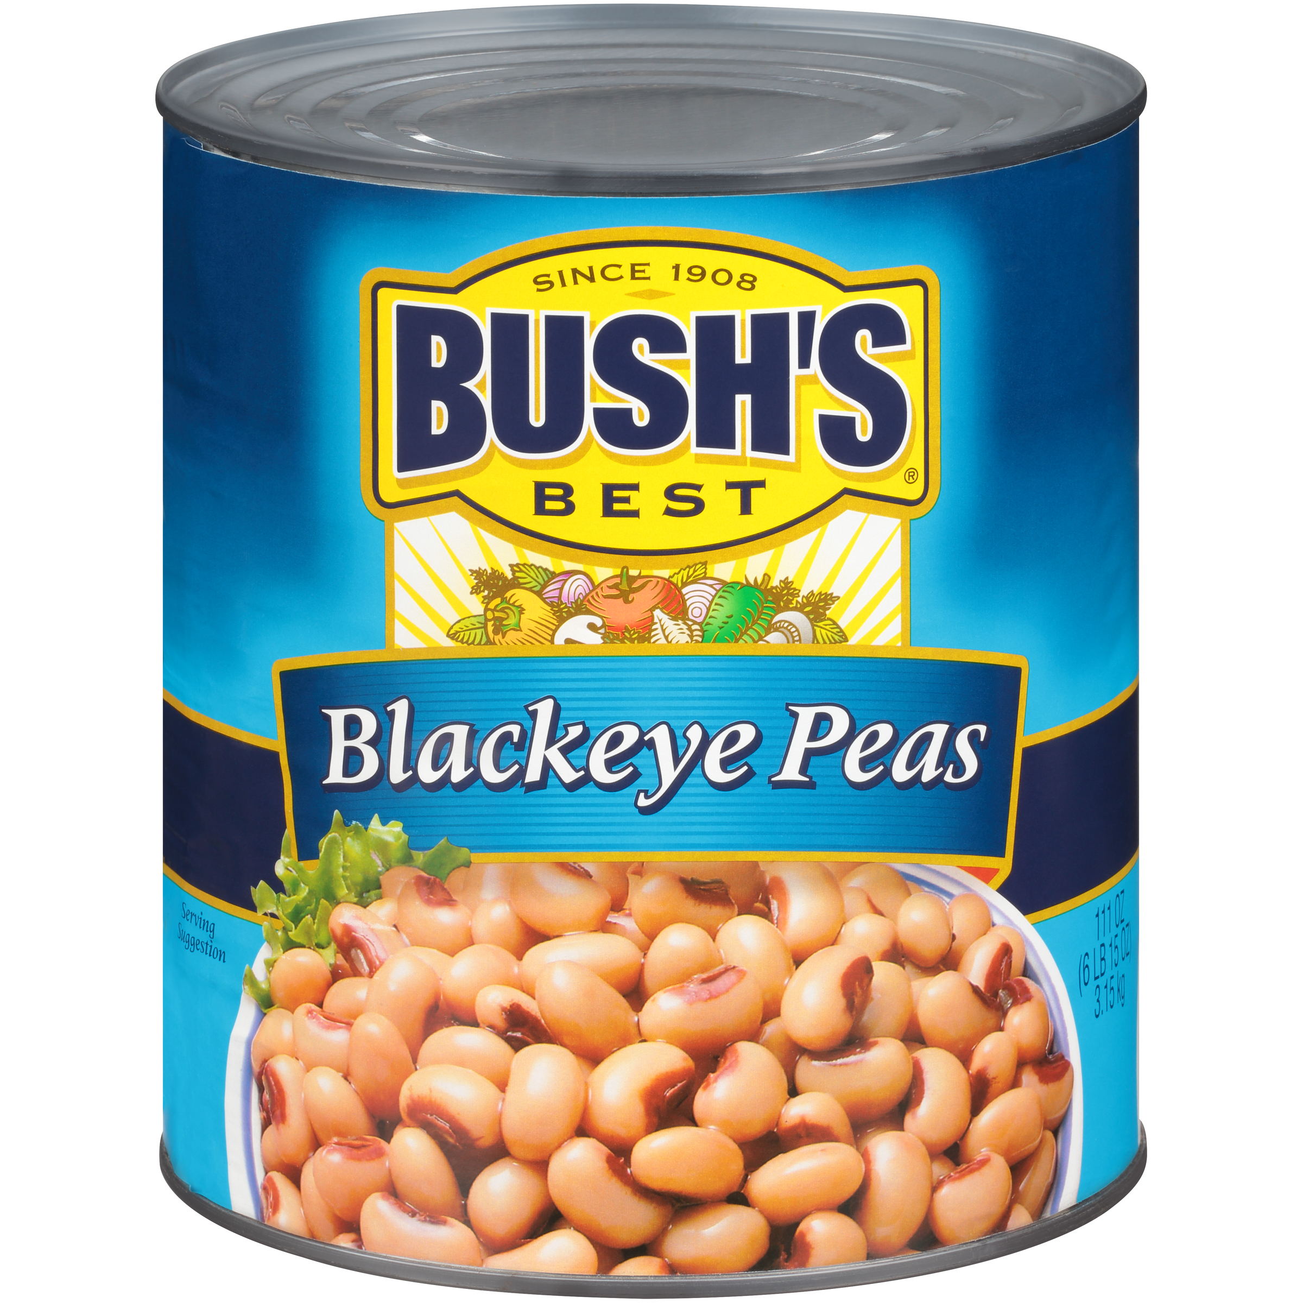

001659 - Bush's Blackeye Peas 111 oz
Cooking and creativity go hand in hand. That's why Bush's Blackeye Peas don't stop at offering plant-based protein and fiber - they open up a whole world of versatility and inspiration. Their mild, hearty flavor and deliciously creamy texture are perfect in a variety of dishes, especially your Southern favorites. So while you may not know exactly what your next creation is going to be, you can rest assured it's going to be great.
Brand: Bush's Best
Nutrition Facts
24 servings per container
Serving Size |  |  | 1/2 cup (130g)
Amount per serving |  |  | 100
Calories
% Daily Value*
Total Fat 0g |  |  | 0%
Saturated Fat 0g |  |  | 0%
Trans Fat 0g
Cholesterol 0mg |  |  | 0%
Sodium 450mg |  |  | 19%
Total Carbohydrate 18g |  |  | 6%
Dietary Fiber 3g |  |  | 11%
Total Sugars 2g
 | Includes 0g Added Sugars |  |  | 0%
Protein 7g |  |  | 11%
⎯⎯⎯⎯⎯⎯⎯⎯⎯⎯⎯⎯⎯⎯⎯⎯⎯⎯⎯⎯⎯⎯⎯⎯⎯⎯⎯⎯⎯⎯⎯⎯⎯⎯⎯⎯⎯⎯⎯⎯⎯
Vitamin D 0mcg 0% |  | Calcium 30mg 2% | Calcium 30mg 2%
Iron 2.4mg 15% |  | Potassium 320mg 6% | Potassium 320mg 6%
⎯⎯⎯⎯⎯⎯⎯⎯⎯⎯⎯⎯⎯⎯⎯⎯⎯⎯⎯⎯⎯⎯⎯⎯⎯⎯⎯⎯⎯⎯⎯⎯⎯⎯⎯⎯⎯⎯⎯⎯⎯⎯ *The % Daily Value (DV) tells you how much a nutrient in a serving of food contributes to a daily diet. 2,000 calories a day is used for general nutrition advice.
Ingredients
Prepared Blackeye Peas, Water, Salt, Disodium EDTA (Promotes Color Retention).
Case Specifications
GTIN | 10039400016592 | Case Gross Weight | Case Gross Weight | 46.4 LB
Pack Size | 6/111 oz | Case Net Weight | Case Net Weight | 41.63 LB
Shelf Life | 1095 days | Case L, W, H | Case L, W, H | 18.75 IN, 12.5 IN, 7 IN
Tie x High | 8 x 7 | Cube | Cube | 0.949 CF
Each Specifications
GTIN | 00039400016595 | Each Gross Weight | Each Gross Weight | 121 ONZ
UPC | 039400016595 | Each Net Weight | Each Net Weight | 111 ONZ
Unit Size | / 111 ONZ | Each L, W, H | Each L, W, H | 6.19 IN, 6.19 IN, 7 IN
 |  | Cube | Cube | 0.155 CF
Preparation and Cooking
Simmer: Empty contents into saucepan. Heat to simmer.
Serving Suggestions
Heat and Serve.
Packaging and Storage
Store in a clean dry place
Allergens
FREE FROM: Eggs or Egg Derivatives, Fish or Fish Derivatives, Milk or Milk Derivatives, Peanuts or Peanut Derivatives, Sesame Seeds or Sesame Derivatives, Soybeans or Soybean Derivatives, Tree Nuts or Tree Nut Derivatives, Wheat or Wheat Derivatives, Crustaceans or Crustacean Derivatives
Barcodes
Each Barcode:
Bush Brothers & Company | 1016 East Weisgarber Rd., Knoxville TN 37909 | bushbeansfoodservice.com | SKU Updated 09.04.2019, Printed 04.09.2024

