Slide 1
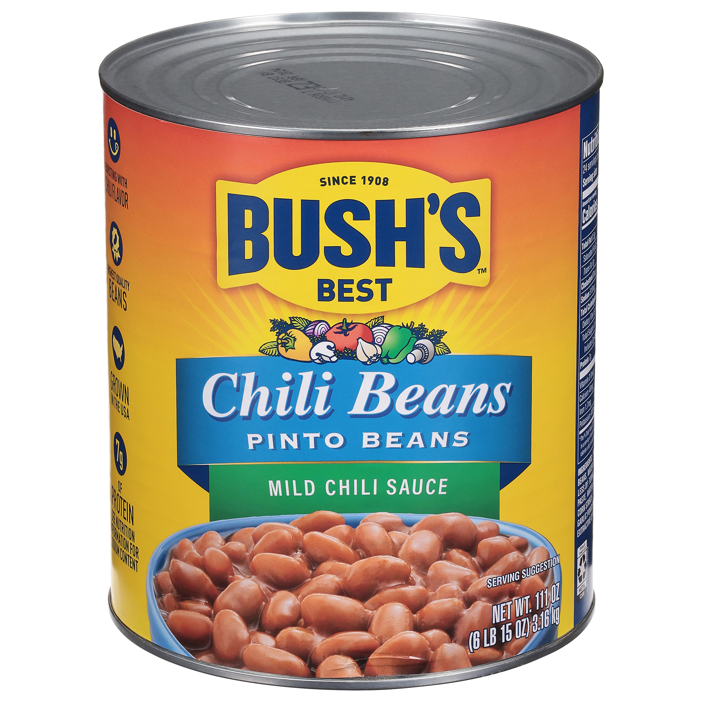
001696 - Bush's Pinto Beans in a Mild Chili Sauce 111 oz
For you, chili isn't just another dish. That's why Bush's Mild Pinto Chili Beans aren't just another ingredient - they're the secret to making your best chili even better. We've already chosen plump, tender pinto beans and slow-simmered them in a sauce perfectly seasoned with the flavors of chili peppers and garlic. All you have to do is add them to your recipe for a homemade meal that tastes like it's been cooking all day, even when it comes together in just a few minutes.
Brand: Bush's Best
Nutrition Facts
24 servings per container
Serving Size |  |  | 1/2 cup (130g)
Amount per serving |  |  | 110
Calories
% Daily Value*
Total Fat 0.5g |  |  | 1%
Saturated Fat 0g |  |  | 0%
Trans Fat 0g
Cholesterol 0mg |  |  | 0%
Sodium 510mg |  |  | 22%
Total Carbohydrate 20g |  |  | 7%
Dietary Fiber 5g |  |  | 17%
Total Sugars 1g
 | Includes <0g Added Sugars |  |  | 0%
Protein 7g |  |  | 8%
⎯⎯⎯⎯⎯⎯⎯⎯⎯⎯⎯⎯⎯⎯⎯⎯⎯⎯⎯⎯⎯⎯⎯⎯⎯⎯⎯⎯⎯⎯⎯⎯⎯⎯⎯⎯⎯⎯⎯⎯⎯
Vitamin D 0mcg 0% |  | Calcium 40mg 4% | Calcium 40mg 4%
Iron 1.7mg 10% |  | Potassium 440mg 10% | Potassium 440mg 10%
⎯⎯⎯⎯⎯⎯⎯⎯⎯⎯⎯⎯⎯⎯⎯⎯⎯⎯⎯⎯⎯⎯⎯⎯⎯⎯⎯⎯⎯⎯⎯⎯⎯⎯⎯⎯⎯⎯⎯⎯⎯⎯ *The % Daily Value (DV) tells you how much a nutrient in a serving of food contributes to a daily diet. 2,000 calories a day is used for general nutrition advice.
Ingredients
Prepared Pinto Beans, Water. Contains 2% or less of: Tomato Puree (Tomato Paste, Water), Salt, Modified Corn Starch, Spice, Corn Oil, Garlic Powder, Onion Powder, Extractive of Paprika.
Case Specifications
GTIN | 10039400016967 | Case Gross Weight | Case Gross Weight | 46.4 LB
Pack Size | 6/111 oz | Case Net Weight | Case Net Weight | 41.63 LB
Shelf Life | 730 days | Case L, W, H | Case L, W, H | 18.75 IN, 12.5 IN, 7 IN
Tie x High | 8 x 7 | Cube | Cube | 0.949 CF
Each Specifications
GTIN | 00039400016960 | Each Gross Weight | Each Gross Weight | 121 ONZ
UPC | 039400016960 | Each Net Weight | Each Net Weight | 111 ONZ
Unit Size | / 111 ONZ | Each L, W, H | Each L, W, H | 6.19 IN, 6.19 IN, 7 IN
 |  | Cube | Cube | 0.155 CF
Preparation and Cooking
Simmer: Empty contents into saucepan. Heat to simmer.
Serving Suggestions
Use as an ingredient in your favorite chili recipe.
Packaging and Storage
Store in a clean dry place
Allergens
FREE FROM: Eggs or Egg Derivatives, Fish or Fish Derivatives, Milk or Milk Derivatives, Peanuts or Peanut Derivatives, Sesame Seeds or Sesame Derivatives, Soybeans or Soybean Derivatives, Tree Nuts or Tree Nut Derivatives, Wheat or Wheat Derivatives, Crustaceans or Crustacean Derivatives
Barcodes
Each Barcode:
Bush Brothers & Company | 1016 East Weisgarber Rd., Knoxville TN 37909 | bushbeansfoodservice.com | SKU Updated 09.04.2019, Printed 04.09.2024

