Slide 1

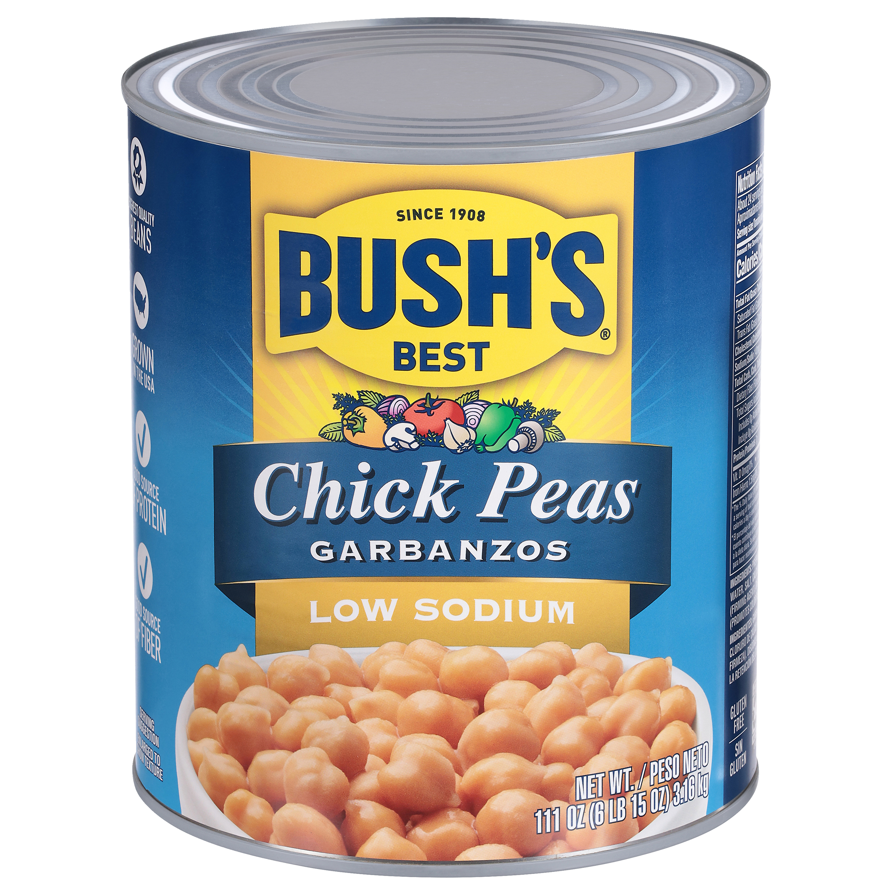

001701 - Bush's Low Sodium Chick Peas 111 oz
Cooking and creativity go hand in hand. That's why Bush's Low Sodium Chick Pea don't stop at offering plant-based protein and fiber - they open up a whole world of versatility and inspiration. And while some people call them "garbanzo beans", everyone agrees they're delicious. Their hearty, nutty flavor and lower sodium content makes them perfect in salads and stews, blended into hummus, fried as falafel and more. So while you may not know exactly what your next creation is going to be, you can rest assured it's going to be great.
Brand: Bush's Best
Nutrition Facts
24 servings per container
Serving Size |  |  | 1/2 cup (130g)
Amount per serving |  |  | 130
Calories
% Daily Value*
Total Fat 2g |  |  | 3%
Saturated Fat 0g |  |  | 0%
Trans Fat 0g
Cholesterol 0mg |  |  | 0%
Sodium 140mg |  |  | 6%
Total Carbohydrate 22g |  |  | 8%
Dietary Fiber 4g |  |  | 15%
Total Sugars 4g
 | Includes 0g Added Sugars |  |  | 0%
Protein 7g |  |  | 11%
⎯⎯⎯⎯⎯⎯⎯⎯⎯⎯⎯⎯⎯⎯⎯⎯⎯⎯⎯⎯⎯⎯⎯⎯⎯⎯⎯⎯⎯⎯⎯⎯⎯⎯⎯⎯⎯⎯⎯⎯⎯
Vitamin D 0mcg 0% |  | Calcium 30mg 2% | Calcium 30mg 2%
Iron 1.5mg 8% |  | Potassium 250mg 6% | Potassium 250mg 6%
⎯⎯⎯⎯⎯⎯⎯⎯⎯⎯⎯⎯⎯⎯⎯⎯⎯⎯⎯⎯⎯⎯⎯⎯⎯⎯⎯⎯⎯⎯⎯⎯⎯⎯⎯⎯⎯⎯⎯⎯⎯⎯ *The % Daily Value (DV) tells you how much a nutrient in a serving of food contributes to a daily diet. 2,000 calories a day is used for general nutrition advice.
Ingredients
Prepared Chick Peas, Water, Salt, Calcium Chloride (Firming Agent), Disodium EDTA (Promotes Color Retention).
Case Specifications
GTIN | 10039400017018 | Case Gross Weight | Case Gross Weight | 46.4 LB
Pack Size | 6/111 oz | Case Net Weight | Case Net Weight | 41.63 LB
Shelf Life | 730 days | Case L, W, H | Case L, W, H | 18.75 IN, 12.5 IN, 7 IN
Tie x High | 8 x 7 | Cube | Cube | 0.949 CF
Each Specifications
GTIN | 00039400017011 | Each Gross Weight | Each Gross Weight | 121 ONZ
UPC | 039400017011 | Each Net Weight | Each Net Weight | 111 ONZ
Unit Size | / 111 ONZ | Each L, W, H | Each L, W, H | 6.19 IN, 6.19 IN, 7 IN
 |  | Cube | Cube | 0.155 CF
Preparation and Cooking
Simmer: Empty contents into saucepan. Heat to simmer.
Serving Suggestions
Add to salads, soups, dips and more.
Packaging and Storage
Store in a clean dry place
Allergens
FREE FROM: Eggs or Egg Derivatives, Fish or Fish Derivatives, Milk or Milk Derivatives, Peanuts or Peanut Derivatives, Sesame Seeds or Sesame Derivatives, Soybeans or Soybean Derivatives, Tree Nuts or Tree Nut Derivatives, Wheat or Wheat Derivatives, Crustaceans or Crustacean Derivatives
Barcodes
Each Barcode:
Bush Brothers & Company | 1016 East Weisgarber Rd., Knoxville TN 37909 | bushbeansfoodservice.com | SKU Updated 09.04.2019, Printed 04.09.2024

