Slide 1

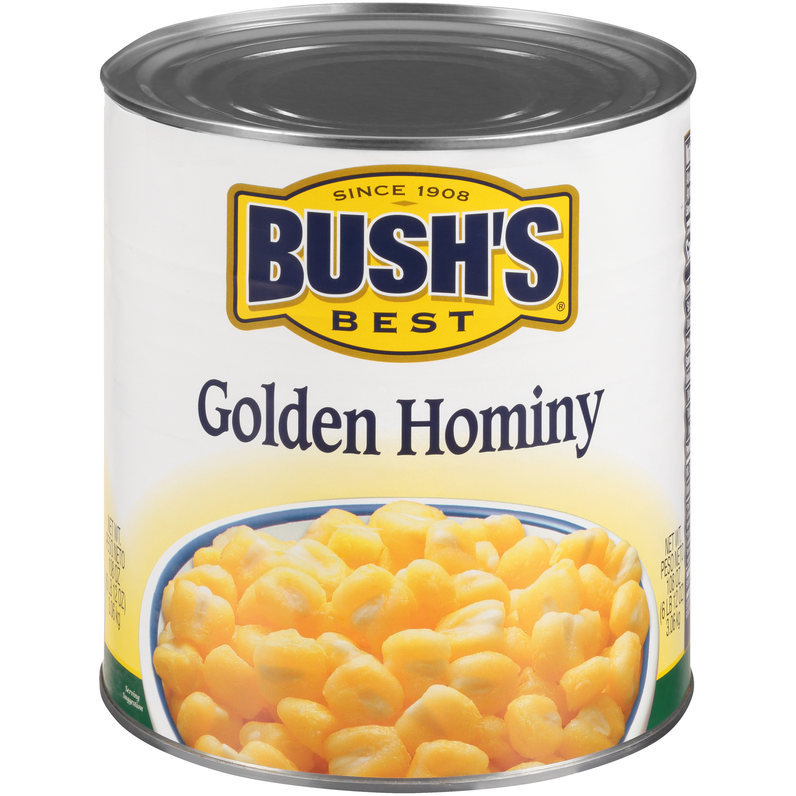

01717 - Bush's Golden Hominy 108 oz
Hominy has been popular for generations, both in Southern and Latin American recipes. Our Golden Hominy begins with the finest golden corn (of course) to get a plump, bright, appetizing kernel with a sweet, mild flavor. Bush's Golden Hominy is often used in place of potatoes or rice to complete a meal, combined with cheese and sweet peppers in casseroles, or as an ingredient in pozole (a Mexican stew).
Brand: Bush's Best
Nutrition Facts
24 servings per container
Serving Size |  |  | 1/2 cup (130g)
Amount per serving |  |  | 80
Calories
% Daily Value*
Total Fat 0.5g |  |  | 1%
Saturated Fat 0g |  |  | 0%
Trans Fat 0g
Cholesterol 0mg |  |  | 0%
Sodium 590mg |  |  | 26%
Total Carbohydrate 17g |  |  | 6%
Dietary Fiber 2g |  |  | 7%
Total Sugars 0g
 | Includes 0g Added Sugars |  |  | 0%
Protein 1g |  |  | 1%
⎯⎯⎯⎯⎯⎯⎯⎯⎯⎯⎯⎯⎯⎯⎯⎯⎯⎯⎯⎯⎯⎯⎯⎯⎯⎯⎯⎯⎯⎯⎯⎯⎯⎯⎯⎯⎯⎯⎯⎯⎯
Vitamin D 0mcg 0% |  | Calcium 0mg 0% | Calcium 0mg 0%
Iron 0mg 0% |  | Potassium 10mg 0% | Potassium 10mg 0%
⎯⎯⎯⎯⎯⎯⎯⎯⎯⎯⎯⎯⎯⎯⎯⎯⎯⎯⎯⎯⎯⎯⎯⎯⎯⎯⎯⎯⎯⎯⎯⎯⎯⎯⎯⎯⎯⎯⎯⎯⎯⎯ *The % Daily Value (DV) tells you how much a nutrient in a serving of food contributes to a daily diet. 2,000 calories a day is used for general nutrition advice.
Ingredients
Prepared Yellow Corn, Salt, Sodium Bisulfite (Promotes Color Retention).
Case Specifications
GTIN | 10039400017179 | Case Gross Weight | Case Gross Weight | 45.8 LB
Pack Size | 6/108 oz | Case Net Weight | Case Net Weight | 40.5 LB
Shelf Life | 730 days | Case L, W, H | Case L, W, H | 18.75 IN, 12.5 IN, 7 IN
Tie x High | 8 x 7 | Cube | Cube | 0.949 CF
Each Specifications
GTIN | 00039400017172 | Each Gross Weight | Each Gross Weight | 118 ONZ
UPC | 039400017172 | Each Net Weight | Each Net Weight | 108 ONZ
Unit Size | / 108 ONZ | Each L, W, H | Each L, W, H | 6.19 IN, 6.19 IN, 7 IN
 |  | Cube | Cube | 0.155 CF
Preparation and Cooking
Simmer: Empty contents into saucepan. Heat to simmer.
Serving Suggestions
Cook into your favorite recipes like casseroles or heat and serve by itself.
Packaging and Storage
Store in a clean dry place
Allergens
FREE FROM: Eggs or Egg Derivatives, Fish or Fish Derivatives, Milk or Milk Derivatives, Peanuts or Peanut Derivatives, Sesame Seeds or Sesame Derivatives, Soybeans or Soybean Derivatives, Tree Nuts or Tree Nut Derivatives, Wheat or Wheat Derivatives, Crustaceans or Crustacean Derivatives
Barcodes
Each Barcode:
Bush Brothers & Company | 1016 East Weisgarber Rd., Knoxville TN 37909 | bushbeansfoodservice.com | SKU Updated 09.04.2019, Printed 04.09.2024

