Slide 1

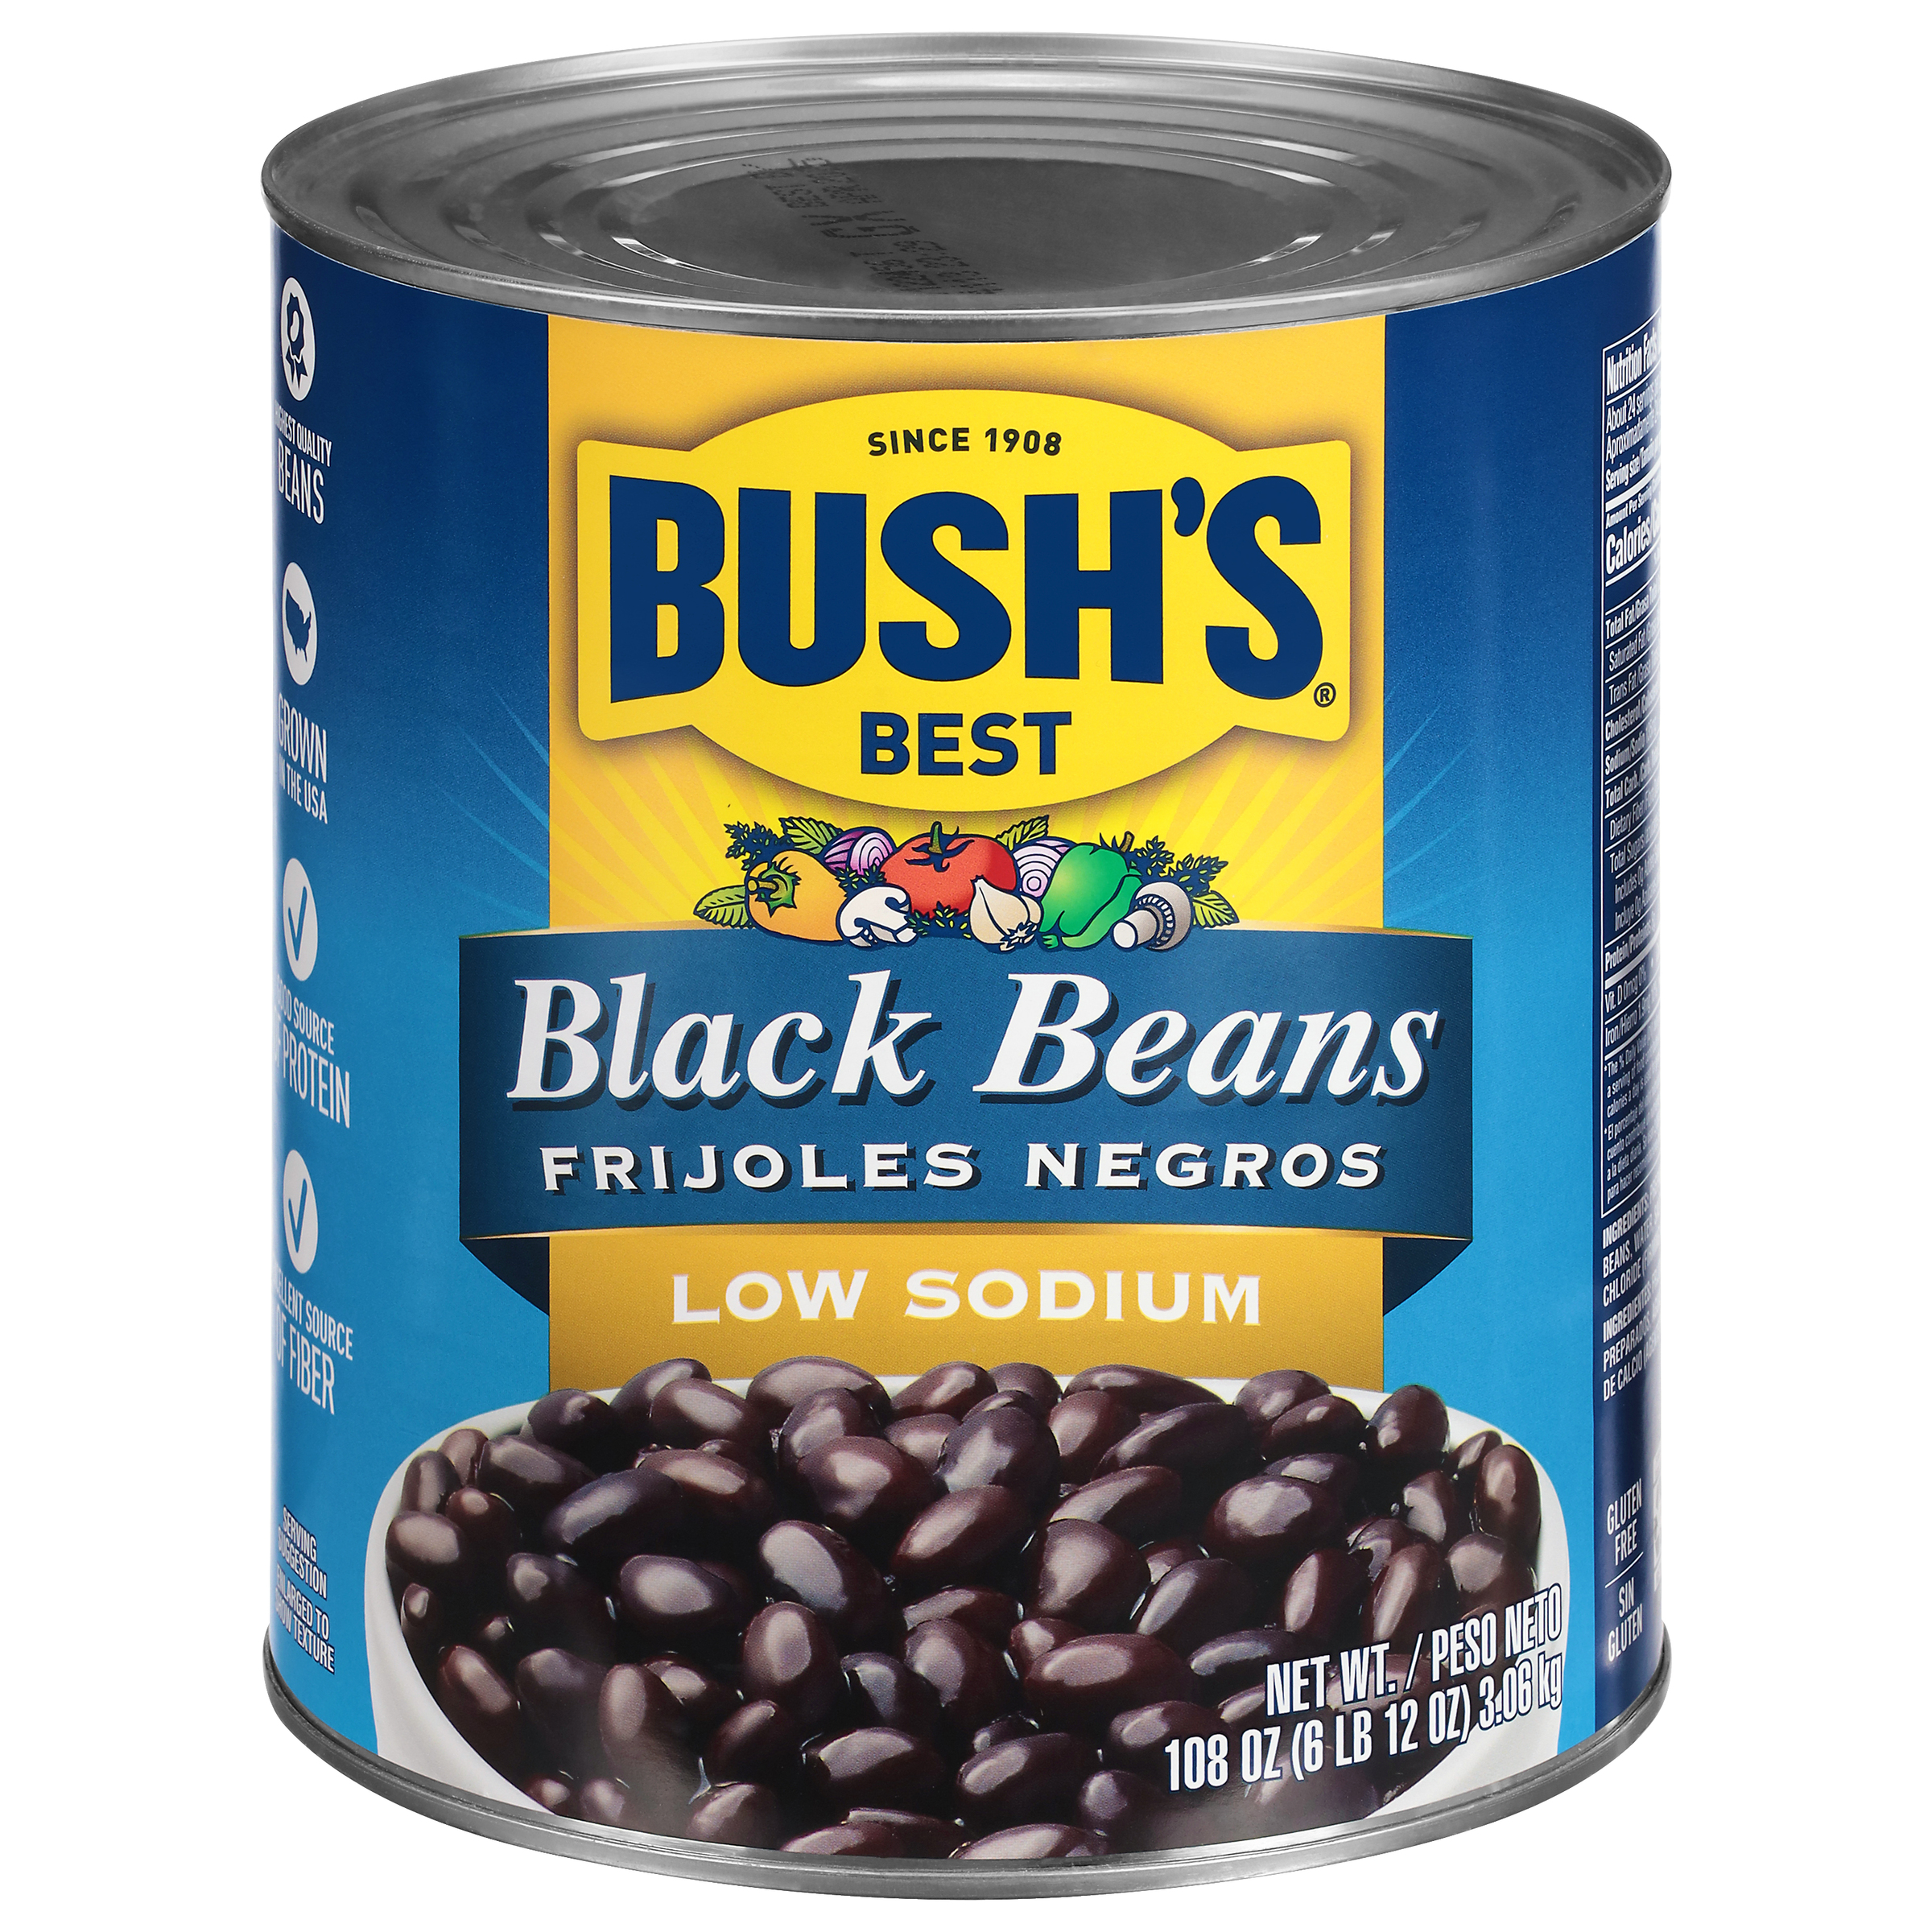

001885 - Bush's Low Sodium Black Beans 108 oz
Cooking and creativity go hand in hand. That's why Bush's Low Sodium Black Beans don't stop at offering plant-based protein and fiber - they open up a whole world of versatility and inspiration. With a deliciously creamy taste and texture and lower sodium than our original Black Beans, they're perfect in soups, with rice, in tacos, puréed in dips and more. So while you may not know exactly what your next creation is going to be, you can rest assured it's going to be great.
Brand: Bush's Best
Nutrition Facts
24 servings per container
Serving Size |  |  | 1/2 cup (130g)
Amount per serving |  |  | 130
Calories
% Daily Value*
Total Fat 0.5g |  |  | 1%
Saturated Fat 0g |  |  | 0%
Trans Fat 0g
Cholesterol 0mg |  |  | 0%
Sodium 135mg |  |  | 6%
Total Carbohydrate 23g |  |  | 9%
Dietary Fiber 6g |  |  | 20%
Total Sugars <1g
 | Includes 0g Added Sugars |  |  | 0%
Protein 8g |  |  | 12%
⎯⎯⎯⎯⎯⎯⎯⎯⎯⎯⎯⎯⎯⎯⎯⎯⎯⎯⎯⎯⎯⎯⎯⎯⎯⎯⎯⎯⎯⎯⎯⎯⎯⎯⎯⎯⎯⎯⎯⎯⎯
Vitamin D 0mcg 0% |  | Calcium 80mg 6% | Calcium 80mg 6%
Iron 1.9mg 10% |  | Potassium 560mg 10% | Potassium 560mg 10%
⎯⎯⎯⎯⎯⎯⎯⎯⎯⎯⎯⎯⎯⎯⎯⎯⎯⎯⎯⎯⎯⎯⎯⎯⎯⎯⎯⎯⎯⎯⎯⎯⎯⎯⎯⎯⎯⎯⎯⎯⎯⎯ *The % Daily Value (DV) tells you how much a nutrient in a serving of food contributes to a daily diet. 2,000 calories a day is used for general nutrition advice.
Ingredients
Prepared Black Beans, Water, Salt, Calcium Chloride (Firming Agent).
Case Specifications
GTIN | 10039400018855 | Case Gross Weight | Case Gross Weight | 45.8 LB
Pack Size | 6/108 oz | Case Net Weight | Case Net Weight | 40.5 LB
Shelf Life | 730 days | Case L, W, H | Case L, W, H | 18.75 IN, 12.5 IN, 7 IN
Tie x High | 8 x 7 | Cube | Cube | 0.949 CF
Each Specifications
GTIN | 00039400018858 | Each Gross Weight | Each Gross Weight | 118 ONZ
UPC | 039400018858 | Each Net Weight | Each Net Weight | 108 ONZ
Unit Size | / 108 ONZ | Each L, W, H | Each L, W, H | 6.19 IN, 6.19 IN, 7 IN
 |  | Cube | Cube | 0.155 CF
Preparation and Cooking
Simmer: Empty contents into saucepan. Heat to simmer.
Serving Suggestions
Perfect In soups, with rice, pureed for dips, or as a stand alone dish
Packaging and Storage
Store in a clean dry place
Allergens
FREE FROM: Eggs or Egg Derivatives, Fish or Fish Derivatives, Milk or Milk Derivatives, Peanuts or Peanut Derivatives, Sesame Seeds or Sesame Derivatives, Soybeans or Soybean Derivatives, Tree Nuts or Tree Nut Derivatives, Wheat or Wheat Derivatives, Crustaceans or Crustacean Derivatives
Barcodes
Each Barcode:
Bush Brothers & Company | 1016 East Weisgarber Rd., Knoxville TN 37909 | bushbeansfoodservice.com | SKU Updated 09.04.2019, Printed 04.09.2024

