Slide 1
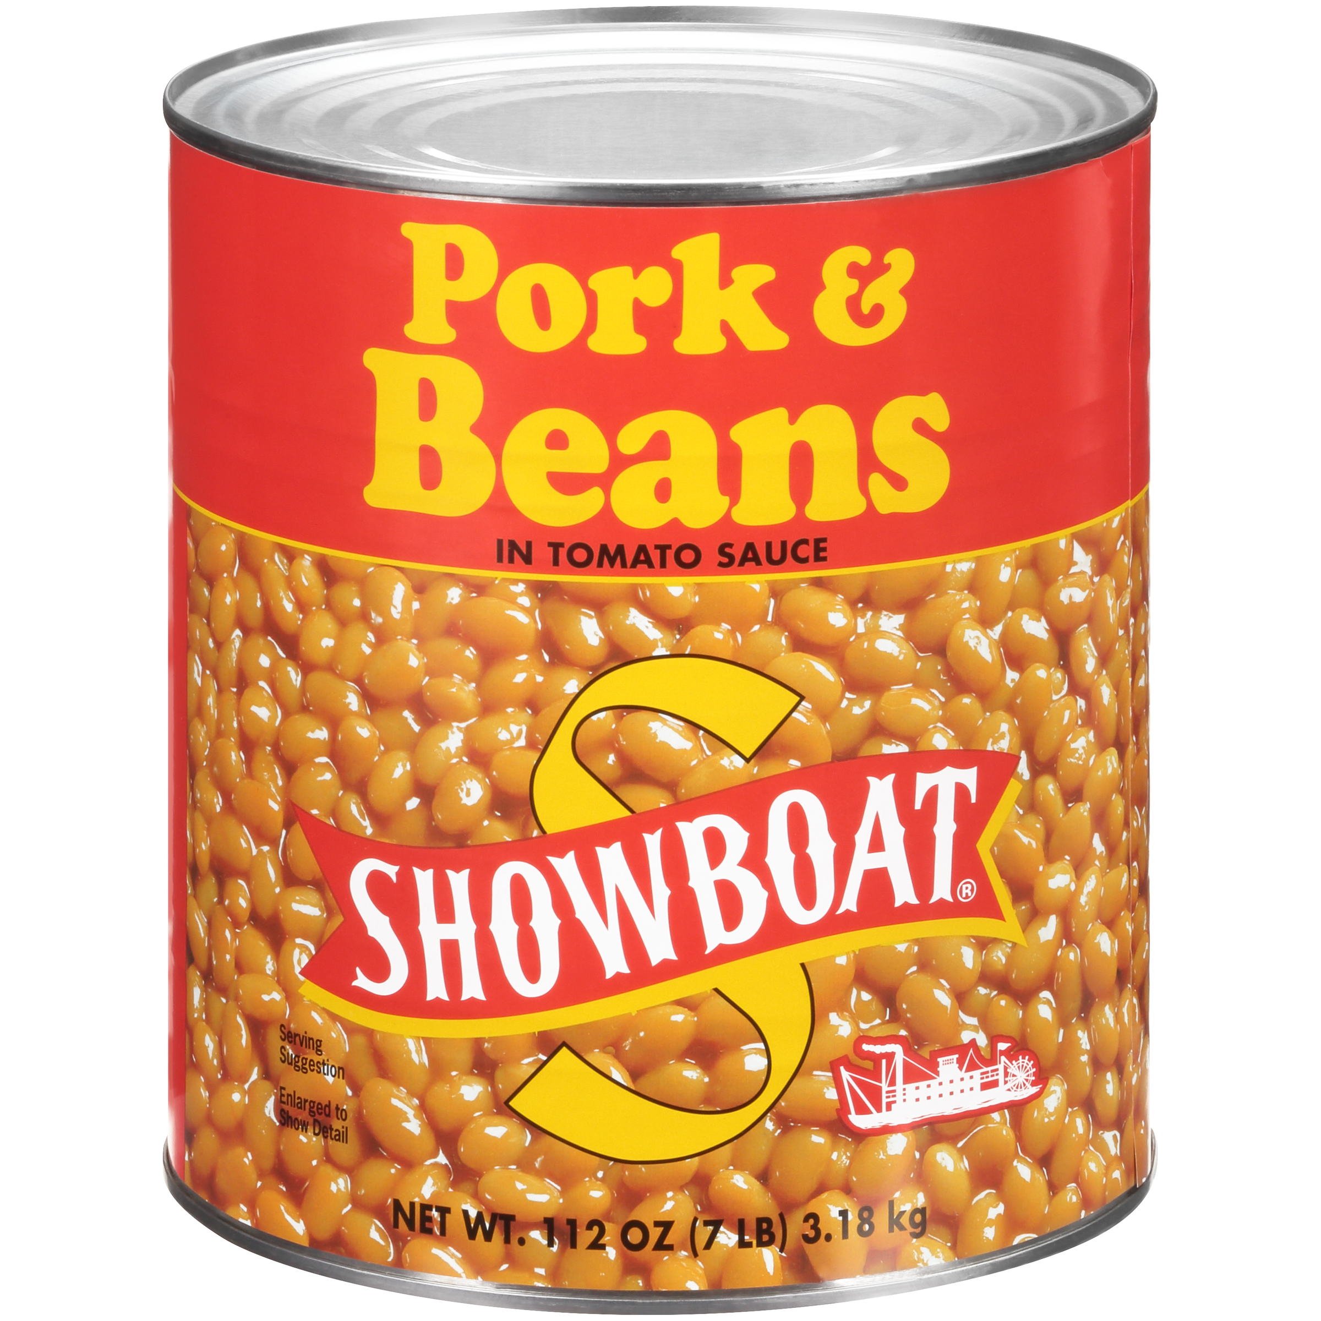
02849 - SHOWBOAT Pork & Beans 112 oz
The best thing about SHOWBOAT Pork & Beans isn't what they are by themselves, but what you can turn them into on your own. This combo of hearty beans and pork in a sweet tomato sauce is customizable to complement your menu.
Brand: SHOWBOAT
Nutrition Facts
24 servings per container
Serving Size |  |  | 1/2 cup (130g)
Amount per serving |  |  | 130
Calories
% Daily Value*
Total Fat 1g |  |  | 1%
Saturated Fat 0g |  |  | 0%
Trans Fat 0g
Cholesterol 0mg |  |  | 0%
Sodium 500mg |  |  | 22%
Total Carbohydrate 24g |  |  | 9%
Dietary Fiber 5g |  |  | 18%
Total Sugars 5g
 | Includes 4g Added Sugars |  |  | 8%
Protein 7g |  |  | 9%
⎯⎯⎯⎯⎯⎯⎯⎯⎯⎯⎯⎯⎯⎯⎯⎯⎯⎯⎯⎯⎯⎯⎯⎯⎯⎯⎯⎯⎯⎯⎯⎯⎯⎯⎯⎯⎯⎯⎯⎯⎯
Vitamin D 0mcg 0% |  | Calcium 60mg 4% | Calcium 60mg 4%
Iron 1.8mg 10% |  | Potassium 390mg 8% | Potassium 390mg 8%
⎯⎯⎯⎯⎯⎯⎯⎯⎯⎯⎯⎯⎯⎯⎯⎯⎯⎯⎯⎯⎯⎯⎯⎯⎯⎯⎯⎯⎯⎯⎯⎯⎯⎯⎯⎯⎯⎯⎯⎯⎯⎯ *The % Daily Value (DV) tells you how much a nutrient in a serving of food contributes to a daily diet. 2,000 calories a day is used for general nutrition advice.
Ingredients
Prepared Navy Beans, Water, Tomato Puree (Tomato Paste, Water), Sugar, Salt, Pork, Modified Corn Starch, Calcium Chloride (Firming Agent), Extractive of Paprika, Spice, Garlic Powder, Natural Flavor.
Case Specifications
GTIN | 10039400028496 | Case Gross Weight | Case Gross Weight | 47 LB
Pack Size | 6/112 oz | Case Net Weight | Case Net Weight | 42 LB
Shelf Life | 730 days | Case L, W, H | Case L, W, H | 18.75 IN, 12.5 IN, 7 IN
Tie x High | 8 x 7 | Cube | Cube | 0.949 CF
Each Specifications
GTIN | 00039400028499 | Each Gross Weight | Each Gross Weight | 122 ONZ
UPC | 039400028499 | Each Net Weight | Each Net Weight | 112 ONZ
Unit Size | / 112 ONZ | Each L, W, H | Each L, W, H | 6.19 IN, 6.19 IN, 7 IN
 |  | Cube | Cube | 0.155 CF
Preparation and Cooking
Simmer: Empty contents into saucepan. Heat to simmer.
Serving Suggestions
Heat and Serve
Packaging and Storage
Store in a clean dry place
Allergens
FREE FROM: Eggs or Egg Derivatives, Fish or Fish Derivatives, Milk or Milk Derivatives, Peanuts or Peanut Derivatives, Sesame Seeds or Sesame Derivatives, Soybeans or Soybean Derivatives, Tree Nuts or Tree Nut Derivatives, Wheat or Wheat Derivatives, Crustaceans or Crustacean Derivatives
Barcodes
Each Barcode:
Bush Brothers & Company | 1016 East Weisgarber Rd., Knoxville TN 37909 | bushbeansfoodservice.com | SKU Updated 09.04.2019, Printed 04.09.2024

